Slide 1

ECE DOMAIN ORIENTATION
EMBEDDED SYSTEMS
From Code to Real-World Machines
A beginner-friendly guide for ECE freshers | IIIT Kottayam
Microcontrollers
Low-Level Software
Intelligent Hardware

Slide 2


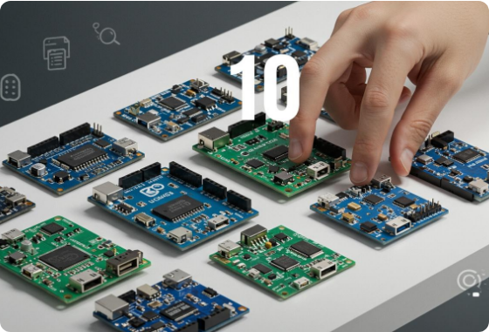
What is an Embedded System?
An embedded system is a specialized computer built inside a device to perform dedicated, real-world control tasks.
Bridges Two Worlds: Connects software decisions with physical hardware.
Intelligent Devices: Drives cars, drones, smartwatches & washing machines.
Targeted Purpose: Optimized for specific timing, memory & efficiency constraints.
INPUT
PROCESS
OUTPUT
Sensors / Buttons
MCU + Software
Motors / Display

Slide 3



Why is Embedded Systems Important?
Modern devices are becoming smarter, fully connected, and automated. Embedded engineers are the architects turning electronic hardware into functional products.
Automotive
IoT & Smart Devices
Critical Industries
Controls critical braking systems, airbags, battery management in EVs, infotainment & autonomous driving (ADAS).
Powers connected sensors that sense, process, and transmit environmental data to cloud networks efficiently.
Essential across medical devices, industrial robotics, aerospace systems, and smart energy infrastructure.
Unifies Core ECE Domains: Electronics + Digital Logic + Programming + Communication + Control Systems

Slide 4
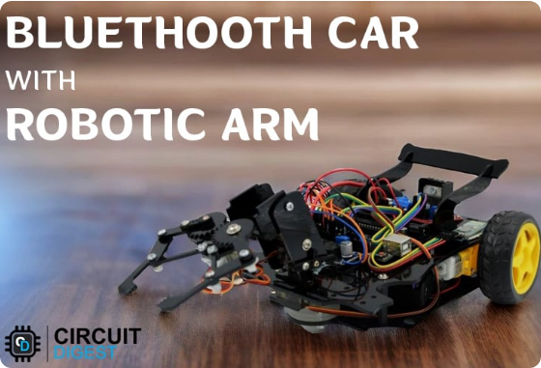
Scope & Career Pathways
Firmware
Hardware
Low-level driver software controlling hardware directly.
Designing PCB circuits & MCU peripherals.
Automotive
Real-Time Systems
ECUs, CAN bus protocols, ADAS & EV systems.
Strict timing limits & RTOS scheduling.
Embedded Linux
Edge AI / TinyML
High-performance processors & OS drivers.
Running ML models directly on MCUs.

Slide 5
Skills Matrix for Freshers
Level | Core Focus Areas | Key Technologies
1. Foundation | C Programming, Logic Gates, Registers, Computer Architecture
2. Core Embedded | MCU Architecture, Inputs/Outputs, Hardware Interrupts & Timers
3. Communication | Chip-to-chip & peripheral communication protocols
4. Advanced & Tools | Real-time scheduling, OS drivers, Oscilloscopes, Debugging
C Language
Git/GitHub
Digital Circuits
GPIO
PWM
ADC
Timers
UART
SPI
I²C
CAN Protocol
FreeRTOS
Embedded Linux
GDB Debugger

Slide 6

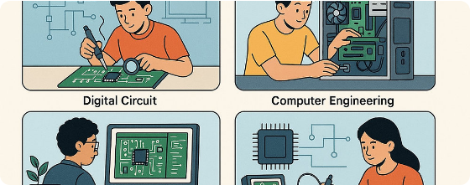
Job Roles & Industry Opportunities
Major Engineering Roles
Embedded Firmware Engineer: Develops MCU low-level code.
Hardware Engineer: Circuit design & PCB validation.
Automotive Embedded Engineer: EV, ECU & ADAS platforms.
Device Driver Developer: OS-to-hardware communication.
IoT & Robotics Engineer: Connected autonomous systems.
KEY TARGET INDUSTRIES
Automotive • Robotics • Consumer Electronics • IoT • Industrial Automation • Medical Devices • Aerospace • Telecom • Defence

Slide 7
Core Strategy for ECE Freshers
The Golden Mindset
"Don't aim to learn every technology immediately. Build strong fundamentals make projects debug them learn deeper specialize."
THE CORE EQUATION
EMBEDDED SYSTEMS = ELECTRONICS + SOFTWARE + REAL-WORLD PROBLEM SOLVING
Focus on C & Logic
Pick 1 MCU Platform
Document on GitHub

Slide 8



Image Sources
https://www.wonderfulpcb.com/wp-content/uploads/2025/10/a96680c422d94e87afe1695685468685.jpg
Source: www.wonderfulpcb.com
https://circuitdigest.com/sites/default/files/projectimage_mic/Bluetooth-Controlled%20Robotic%20Arm%20Car%20using%20Arduino%20Uno.jpg
Source: circuitdigest.com
https://static.wixstatic.com/media/b9cef4_3120e758f4f1432ead016673e5485a92~mv2.jpg/v1/fill/w_1000,h_667,al_c,q_85,usm_0.66_1.00_0.01/b9cef4_3120e758f4f1432ead016673e5485a92~mv2.jpg
Source: www.projectmanagertemplate.com

